Slide 1
Predicting User Engagements for TikTok 📱♪

Slide 2
Goal To develop a robust predictive model for TikTok user engagement and identify key factors influencing engagement rates.
Dataset Overview
1000 TikTok profiles
Key metrics: followers, following, likes, video count, engagement rates
Data Preprocessing
Remove 'create_time' and 'bio_link' columns due to missing data.
Rename some columns for clarity (e.g., 'awg_engagement_rate' to 'avg_engagement_rate’).
Handle missing values by dropping rows with any null values.
Outliers are identified and removed using the Interquartile Range (IQR) method for key metrics.

Slide 3
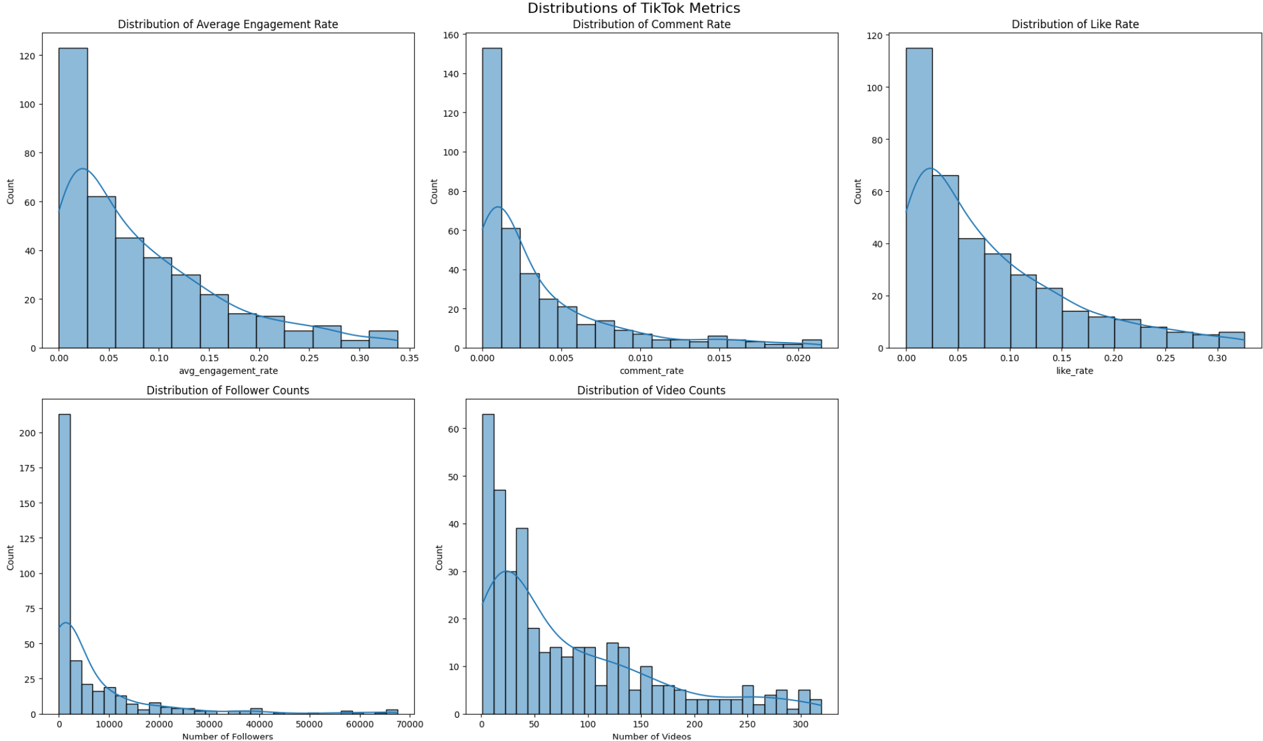
Visualization and Analysis
Average Engagement Rate:
Distribution: Right-skewed, indicating most profiles have lower engagement rates, with a few having very high rates.
Comment Rate:
Distribution: Highly right-skewed, indicating most videos receive few comments relative to views.
Like Rate:
Distribution: Right-skewed, indicating most videos receive a moderate number of likes, with some receiving very high like rates.
Follower Counts:
Distribution: Extremely right-skewed, suggesting most accounts have relatively few followers, while a small number have very large followings.
Video Counts:
Distribution: Right-skewed, indicating most accounts have fewer videos, with some accounts having a very high number of videos.

Slide 4
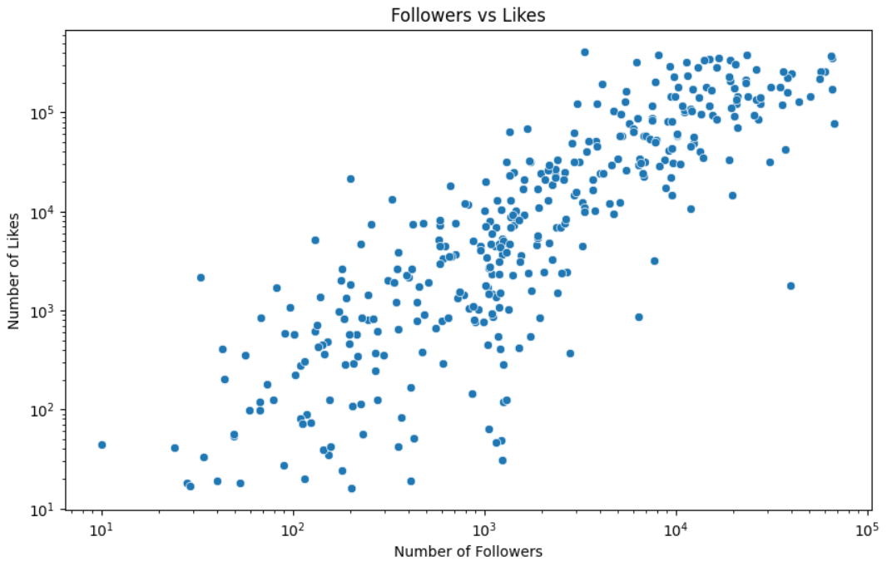
Scatter Plot: Followers vs. Likes
Positive Correlation:
Clear positive correlation; as the number of followers increases, the number of likes tends to increase.

Slide 5
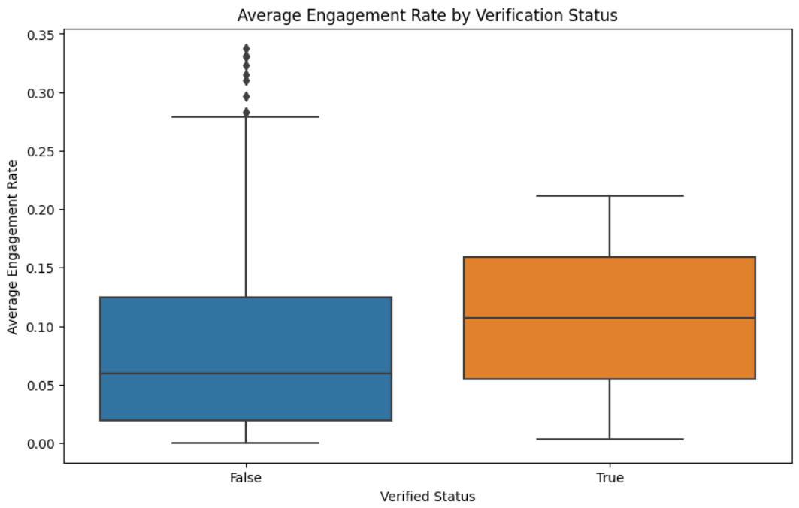
Box Plot: Engagement Rates of Verified vs. Non-Verified Accounts
Verified accounts (True) have a higher median engagement rate compared to non-verified accounts (False).
The median for verified accounts is around 0.10 (10%), while for non-verified accounts it's about 0.06 (6%).

Slide 6
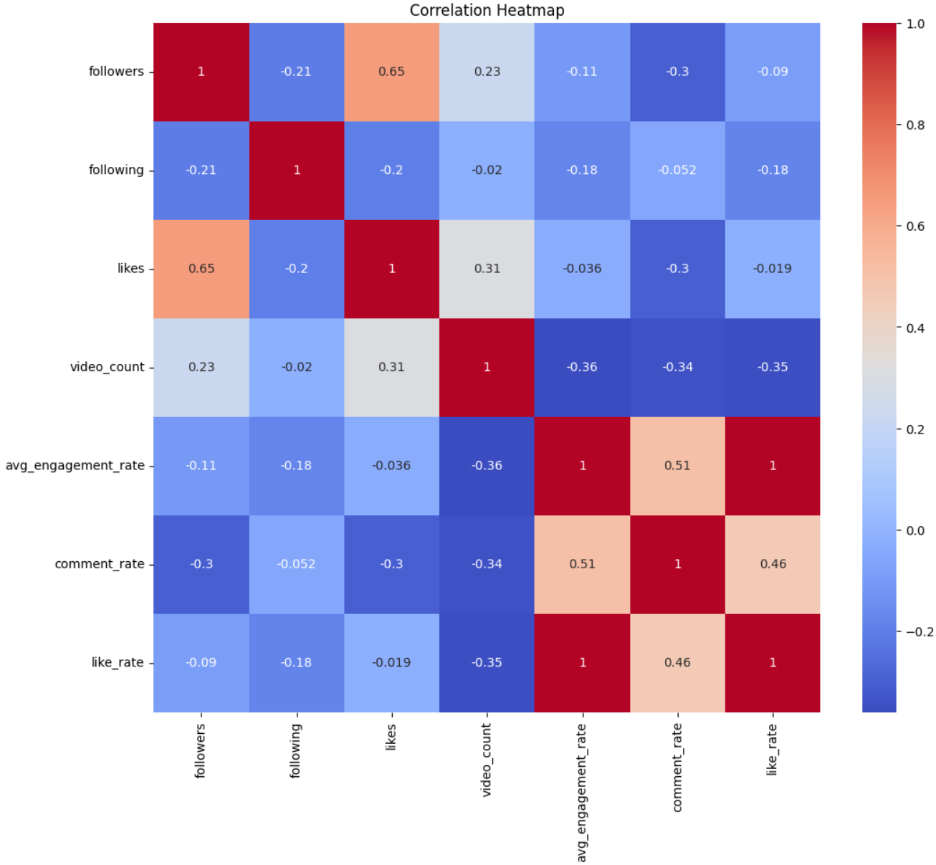
Correlation Heatmap
Followers and Likes (0.65): Strong positive correlation, indicating that accounts with more followers tend to get more likes.
Avg_engagement_rate, Comment_rate, and Like_rate: These three metrics are highly correlated with each other (0.51 to 1.0).This suggests that accounts with high engagement in one area tend to have high engagement in others.
Video_count and Engagement Metrics: Negative correlations with avg_engagement_rate (-0.36), comment_rate (-0.34), and like_rate (-0.35).This implies that accounts with more videos tend to have slightly lower engagement rates, possibly due to content saturation.
Followers and Engagement Metrics: Weak negative correlations with avg_engagement_rate (-0.11), comment_rate (-0.3), and like_rate (-0.09).Suggests that as follower count increases, engagement rates tend to decrease slightly, possibly due to a broader, less engaged audience.
Following and Other Metrics: Generally weak negative correlations with most metrics.The number of accounts a user follows doesn't strongly influence other engagement metrics.
Likes and Video_count (0.31): Moderate positive correlation, indicating that accounts with more videos tend to accumulate more likes overall.

Slide 7
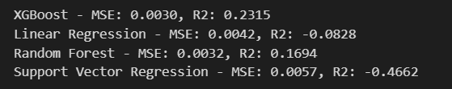
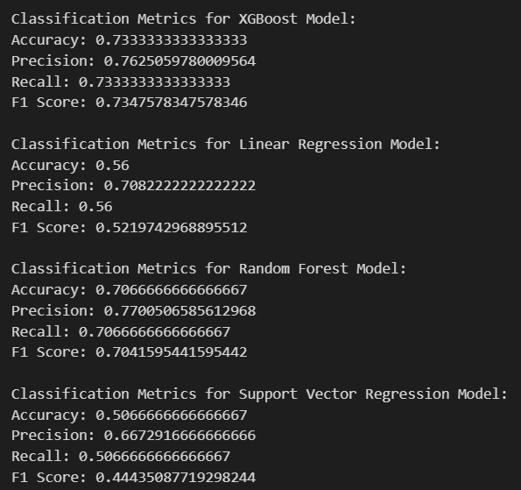
Model Evaluation
XGBoost MSE: 0.0030(Lower is better) R2: 0.2315(Higher is better)
Linear Regression MSE: 0.0042 R2: -0.0828
Random Forest MSE: 0.0032 R2: 0.1694
Support Vector Regression (SVR) MSE: 0.0057R2: -0.4662
From our evaluation, XGBoost stands out as the best model for predicting TikTok user engagement. It achieves the lowest MSE and highest R2 in regression tasks, indicating its superior ability to explain the variance in engagement rates. In classification tasks, XGBoost also shows the highest accuracy, precision, recall, and F1 score, making it the most balanced and reliable model.
Random Forest is also a strong contender, performing well in both regression and classification, though not quite as well as XGBoost.
Linear Regression and Support Vector Regression fall short, particularly in regression tasks where their negative R2 scores indicate poor performance. In classification, they also underperform.

Slide 8
CONCLUSION
TikTok user engagement can be predicted with good accuracy using machine learning.
Success on the platform requires a balanced approach of consistent content creation, audience building, and maintaining content quality. As TikTok evolves, continuous monitoring and model updates will be crucial for maintaining predictive accuracy.
Future Work:
Feature Engineering:
Incorporate content-specific features (e.g., hashtags, music)
Hyperparameter Tuning:
Optimize model performance with techniques such as Grid Search or Random Search.
Temporal Analysis:
Integrate time-series analysis to capture trends and patterns over time.
Model Interpretability:
Use tools like SHAP or LIME to gain insights into feature importance and model decisions.
Cross-platform Analysis:
Expand the study to other social media platforms for a broader perspective on user engagement.
Investigate the impact of TikTok algorithm changes on engagement.

Slide 9
Business Strategies
Improved User Engagement: By understanding and predicting what drives user engagement, TikTok can tailor its content recommendation algorithm to boost user interaction and satisfaction.
Targeted Marketing: Insights from the models can inform more effective marketing strategies, targeting users with personalized content and promotions based on their predicted engagement levels.
Resource Optimization: Accurate engagement predictions can help optimize resource allocation for content creation, curation, and promotion, ensuring that efforts are focused on high-impact areas.
Strategic Decision-Making: Data-driven insights enable more informed strategic decisions, from feature development to user acquisition and retention strategies.

Slide 10
THANKS!
Presented by,
Group 1

